Slide 1
SERMON CONVERSATION — SMALL GROUP
Caretakers of the Soil
Watch a little. Talk a lot. · Matthew 13:1-9 & Matthew 13:18-23
Generated by Echo · echochurch.app
Notes:
Open in PowerPoint or import to Google Slides. Clip slides have the horizontal 16:9 sermon clip embedded — click to play in the room.

Slide 2
HOW TONIGHT WORKS
3 short clips. 3 conversations.
1
2
3
4
Play the clip
Sit a second
Talk it through
Next clip
A short piece of Sunday's sermon — shown full-screen, as filmed.
Let it land. No rush to fill the silence.
One question on the screen. Go wherever the group takes it.
Repeat. End by praying for each other.

Slide 3
OPEN THE SCRIPTURE · READ ALOUD
Matthew 13:1-9 · Matthew 13:18-23
Read aloud. Then hold three questions — they work whether it's your first time in the text or your hundredth:
1 What does this Scripture tell us about God?
2 What does it tell us about humanity?
3 What does it tell us about the relationship between God and humanity?
Notes:
THE STANDARD WEEKLY SLIDE — the sermon's scripture(s) + the three evergreen questions. Everything else in this deck is built from the preacher's words.

Slide 4
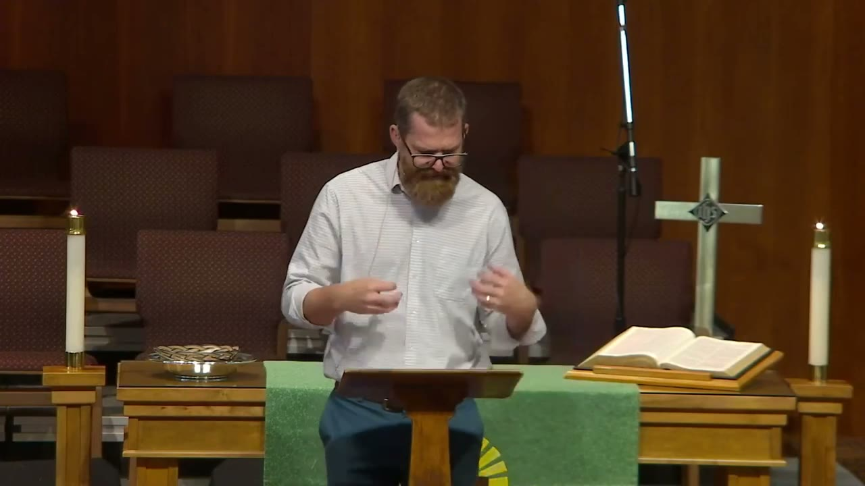
CLIP 1
NOT SOWERS — CARETAKERS
Sermon 40:41-41:28
Notes:
CLIP SOURCE → Sermon 40:41-41:28. Embedded horizontal 16:9 clip — click to play. Quote: The parable of the sower gives us a lot of agency — not to save people, but to be caretakers of the soil

Slide 5
TALK IT THROUGH
If your role isn't to save anyone or even to spread the seed, but to care for the soil around you — what does that actually change about how you think of your responsibility to the people in your life?
— What does 'caring for the soil' look like in a relationship you're already in — not a grand gesture, but something ordinary?
— Is there a part of your own inner soil that you've been neglecting, assuming it would stay good on its own?

Slide 6
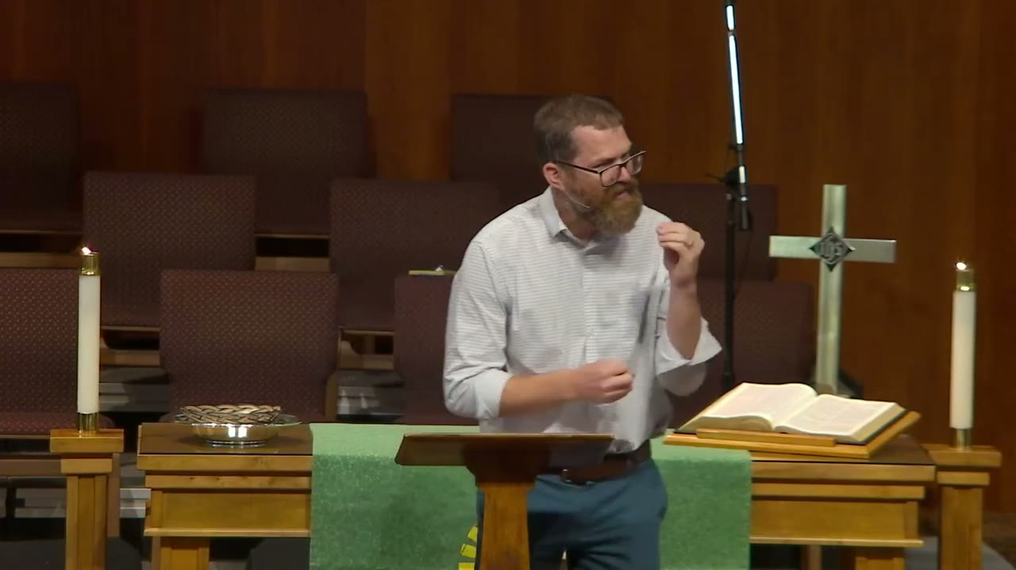
CLIP 2
EVERY ENCOUNTER A MIRACLE
Sermon 45:28-46:00
Notes:
CLIP SOURCE → Sermon 45:28-46:00. Embedded horizontal 16:9 clip — click to play. Quote: Every encounter with Jesus Christ is a miracle — whether you were on death row or just woke up one day and decided to follow him

Slide 7
TALK IT THROUGH
Wilson says every encounter with Jesus Christ is a miracle — whether it was dramatic or quiet. How do you tend to measure or compare your own story of faith, and what does it do to you when you do that?
— Is there something about the way you came to faith — or are still coming to faith — that you've quietly dismissed as not dramatic enough to be worth sharing?
— What would it mean to treat your own story as genuinely worth offering to someone else?

Slide 8
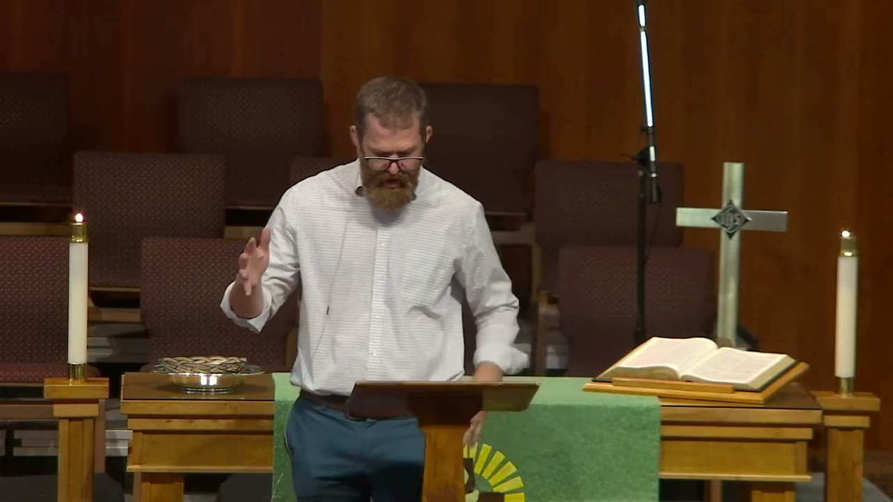
CLIP 3
PULL ONE WEED
Sermon 48:53-49:21
Notes:
CLIP SOURCE → Sermon 48:53-49:21. Embedded horizontal 16:9 clip — click to play. Quote: We can till the soil a little bit, pull a weed, serve with them, not for them — the still small way God enters each of our lives

Slide 9
TALK IT THROUGH
Wilson lists a handful of small things — till the soil a little, pull a weed, serve with someone, pray, invite — and calls these 'the still small way God enters each of our lives.' Which of those feels most natural to you, and which feels most out of reach right now?
— Is there one person in your life you could take one small, concrete step toward this week — not to fix anything, but just to tend the ground a little?
— Wilson makes a point of saying 'serve with them, not for them.' What's the difference, and does that distinction change anything for you?

Slide 10
Pray for the person on your right — by name.
You don't leave church — you are sent. Go care for the soil around you.
Generated by Echo · echochurch.app · draft for review

